Slide 1
Tweets classification using machine learning
UID: 111718031015- Karnati Kusuma
111718031039- Vattipally Vindhya Vasini

Slide 2
Abstract
Tweets classification is to classify tweets from twitter into “positive” or “negative”. Twitter is a microblogging website where people can share their feelings quickly and spontaneously by sending tweets. The proposed work attempts a novel approach on twitter data by aggregating an adapted polarity lexicon which has learnt from product reviews of the domains under consideration, the tweet specific features and unigrams to build a classifier model using machine learning techniques.

Slide 3
Introduction
Tweets classification is to classify the tweets into “positive” or “negative”. The tweets are collected from the twitter and categorized into three columns ‘id’, ‘label’ and ‘tweet’. The label column contains binary operations 0 and 1 representing positive and negative respectively.
The algorithms used are passive aggressive, random forest, decision trees, SVC/SVM, multinominalnb, graph. These algorithms are used because the accuracy is more compared to other algorithms. These are machine learning algorithms and are more efficient.

Slide 4
Existing system
For implementation, the dataset is firstly processed, and then a supervised learning algorithm, Naïve Bayes, is applied. To implement Naïve Bayes algorithm a trained SentiWordNet dictionary is needed which is available online. Two methodologies are used to implement Naïve Bayes. Method 1 works on maps phase which reads the content of the SentiwordNet dictionary from a file and transform into the Hash map for key-value based polarity retrieval of words for faster processing. Method 2 is a reduce phase that collects the overall polarity of each tweet and transform into 5 different categories as positive, negative

Slide 5
Proposed system
In machine learning both classifiers achieve the best results when using the features of the passive aggressive, decision trees, multinomialnb, random forest, SVC/SVM. We get the best accuracy for the tweet we predict using these algorithms.

Slide 6
Packages
Pandas
Numpy
Sklearn
Matplotlib

Slide 7
System requirements
Software Requirements
For developing the application the following are the Software Requirements:
Python
Tkinter
Operating Systems supported
Windows 7
Windows XP
Windows 8
Technologies and Languages used to Develop
Python
Debugger and Emulator
Any Browser (Particularly Chrome)

Slide 8
System requirements
Hardware Requirements
For developing the application the following are the
Hardware Requirements:
Processor: Pentium IV or higher
RAM: 256 MB
Space on Hard Disk: minimum 512MB

Slide 9
ALGORITHMS
1.Passive aggressive:
The Passive-Aggressive algorithms are a family of Machine learning algorithms that are not very well known by beginners and even intermediate Machine Learning enthusiasts.

Slide 10
2.Decision Tree :
Decision tree is the most powerful and popular tool for classification and prediction. A Decision tree is a flowchart like tree structure, where each internal node denotes a test on an attribute, each branch represents an outcome of the test, and each leaf node (terminal node) holds a class label.

Slide 11
3. Multinomialnb:
Multinomial Naive Bayes algorithm is a probabilistic learning method that
is mostly used in Natural Language Processing(NLP). The algorithm is based on the Bayes theorem and predicts the tag of a text such as a piece of email or newspaper article. It calculates the probability of each tag for a given sample and then gives the tag with the highest probability as output.
4. Random forest:
A Random Forest is an ensemble technique capable of performing both regression and classification tasks with the use of multiple decision trees and a technique called Bootstrap and Aggregation, commonly known as bagging. The basic idea behind this is to combine multiple decision trees in determining the final output rather than relying on individual decision trees.

Slide 12
5. SVC/SVM: Support Vector Machine(SVM) is a supervised machine learning algorithm used for both classification and regression. Though we say regression problems as well its best suited for classification. The objective of SVM algorithm is to find a hyperplane in an N-dimensional space that distinctly classifies the data points.
6. Graph:
It is a diagram showing the relation between variable quantities, typically of two variables, each measured along one of a pair of axes

Slide 13
DESIGN PHASE

Slide 14
UML DIAGRAMS:
UML stands for Unified Modelling Language
UML is a standard language for specifying, visualizing, constructing, and documenting the artifacts of software systems.
UML was created by the Object Management Group (OMG) and UML 1.0 specification draft was proposed to the OMG in January 1997.
UML is not a programming language but tools can be used to generate code in various languages using UML diagrams. UML has a direct relation with object oriented analysis and design. After some standardization, UML has become an OMG standard.

Slide 15
UML is different from the other common programming languages such as C++, Java, COBOL, etc.
UML is a pictorial language used to make software blueprints.
UML can be described as a general purpose visual modeling language to visualize, specify, construct, and document software system.
Although UML is generally used to model software systems, it is not limited within this boundary. It is also used to model non-software systems as well. For example, the process flow in a manufacturing unit, etc.

Slide 16
USE CASE DIAGRAM:
A use case diagram in the UML is a type of behavioral diagram defined by and created from a Use-case analysis. Its purpose is to present a graphical overview of the functionality provided by a system in terms of actors, their goals (represented as use cases), and any dependencies between those use cases. The main purpose of a use case diagram is to show what system functions are performed for which actor. Roles of the actors in the system can be depicted.

Slide 17
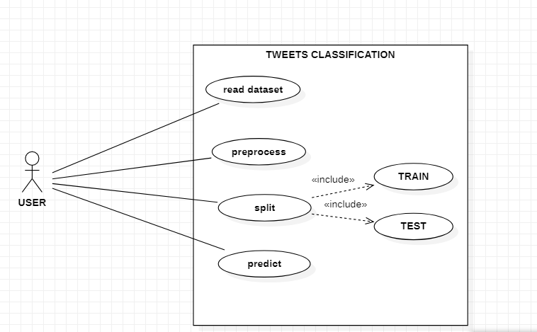

Slide 18
ACTIVITY DIAGRAM:
Activity diagrams are graphical representations of workflows of stepwise activities and actions with support for choice, iteration and concurrency. In the Unified Modeling Language, activity diagrams can be used to describe the business and operational step-by-step workflows of components in a system. An activity diagram shows the overall flow of control.

Slide 19
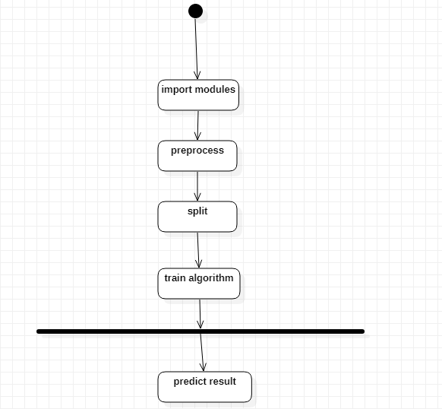

Slide 20
CLASS DIAGRAM:
In software engineering, a class diagram in the UML is a type of static structure diagram that describes the structure of a system by showing the system's classes, their attributes, operations (or methods), and the relationships among the classes. It explains which class contains information.

Slide 21
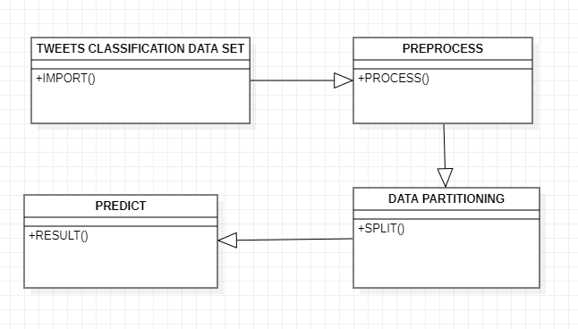

Slide 22
IMPLEMENTATION PHASE

Slide 23
Modules
Load dataset:
Using pandas we will upload dataset.
Split the data set:
Here data will be split into two categories. One is training another one is testing dataset.

Slide 24
1.Training dataset:
The train set would contain the data which will be fed into the model. In simple terms, our model would learn from this data. For instance, a Regression model would use the examples in this data to find gradients in order to reduce the cost function.
2.Test data set:
Test data set will test the data set using algorithm. The test set contains the data on which we test the trained and validated model. It tells us how efficient our overall model is and how likely is it going to predict something which does not make sense.
Predict data set:
Predict() method will predict the results

Slide 25
OUTPUT SCREENS

Slide 26
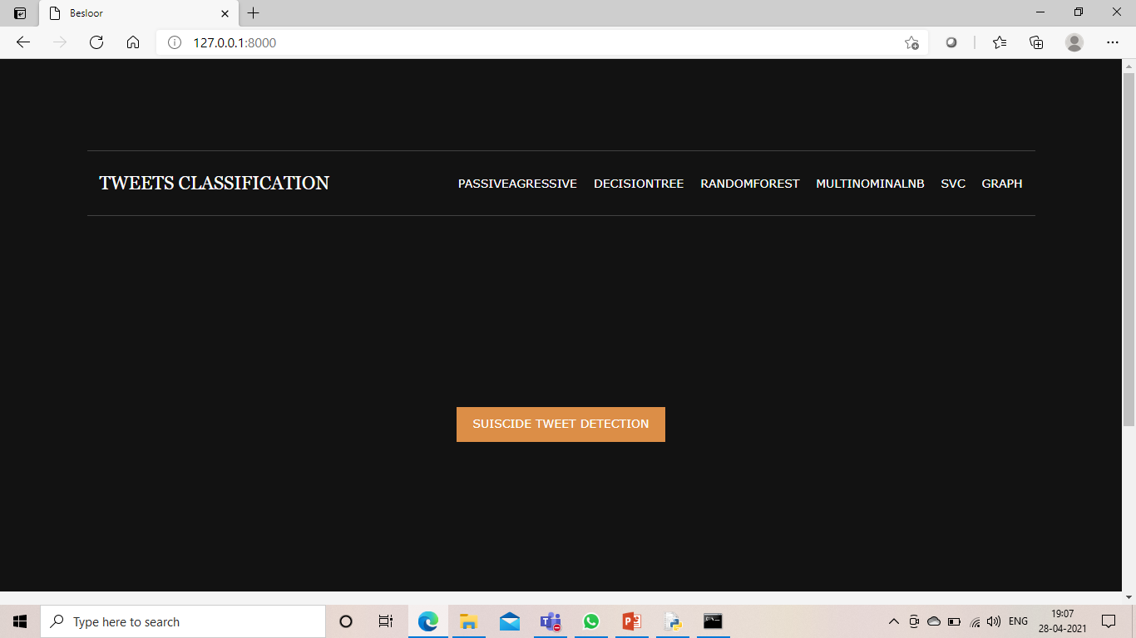

Slide 27
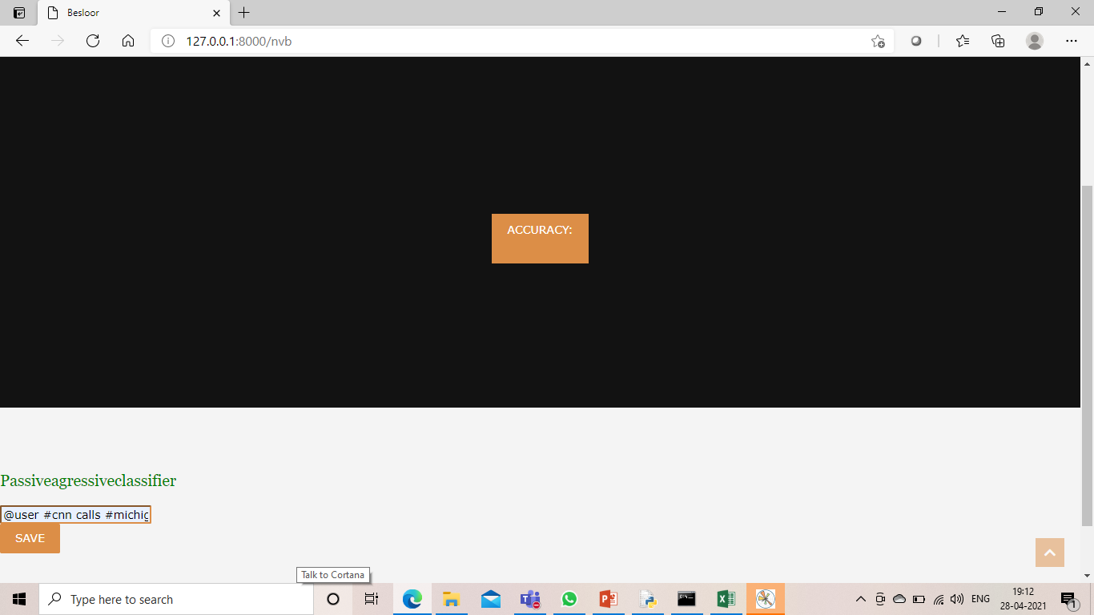

Slide 28
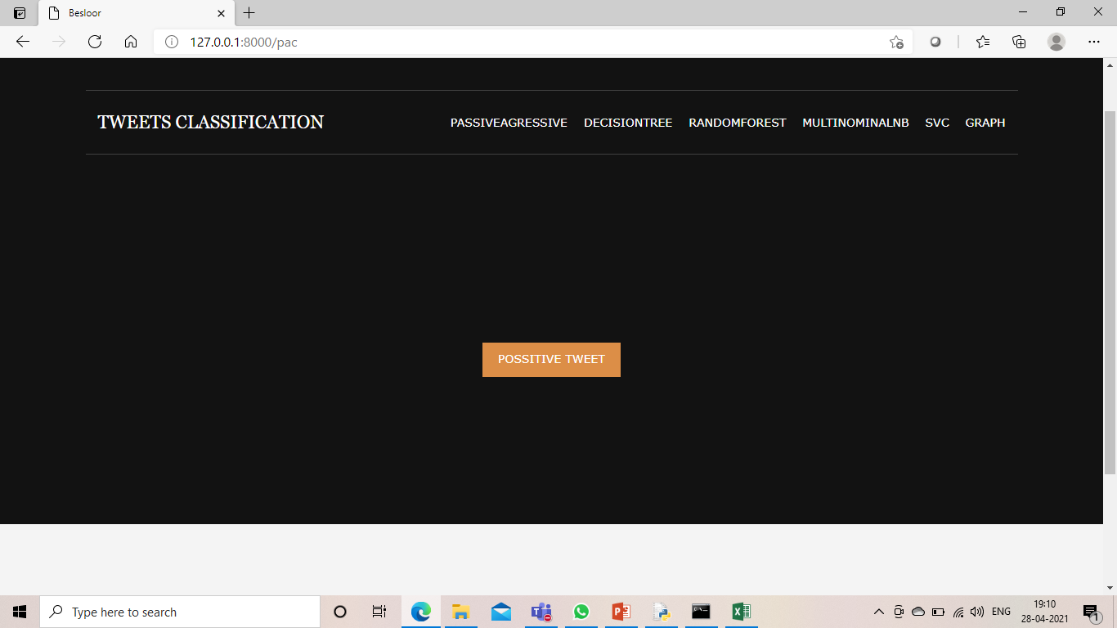

Slide 29
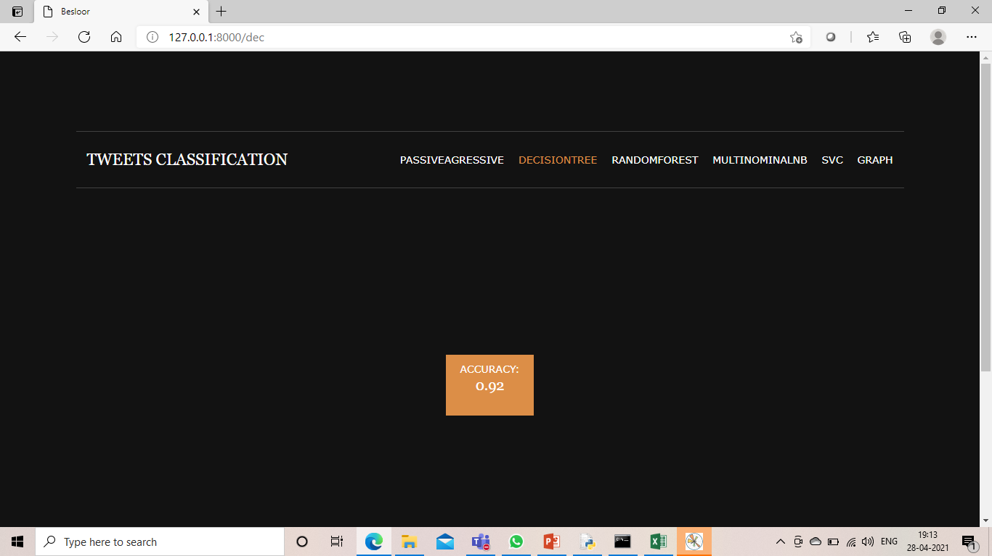

Slide 30


Slide 31
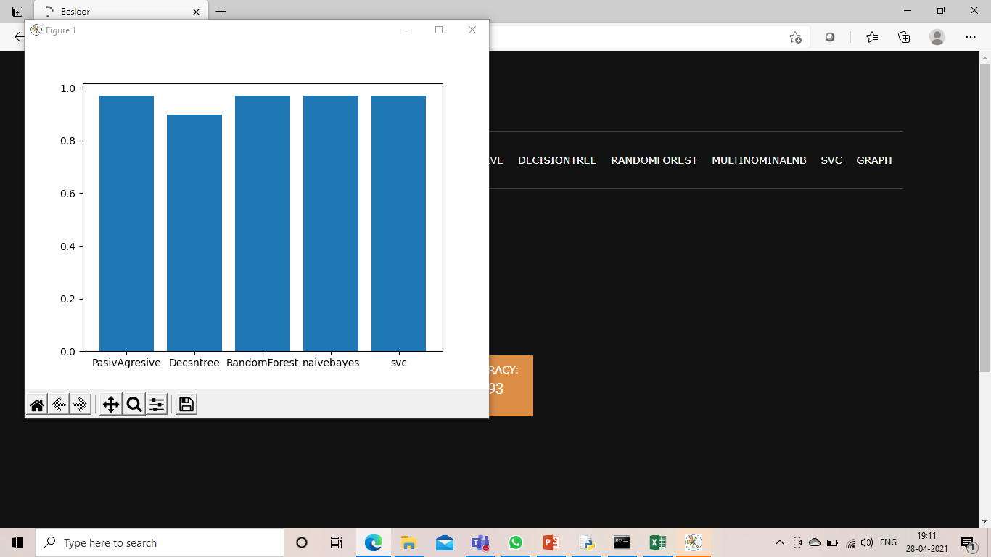

Slide 32
CONCLUSION
Hence, we conclude that the tweets are classified as positive or negative using these algorithms. Also we can say that the accuracy is more based on the tweet. We used the above algorithms because the accuracy shows more compared to naïve bayes etc. The graph algorithm shows the graph of the accuracy of the tweet that is positive or negative.

Slide 33
FUTURE SCOPE
The existing approaches also have some limitations such as low accuracy, low efﬁciency, and restricted application domain. This review brings a new insight analysis on various tweets classiﬁcation methods in different contexts. First we need to improve the pre-processing and classiﬁcation algorithm to enhance accuracy and efﬁciency.

Slide 34


